Slide 1
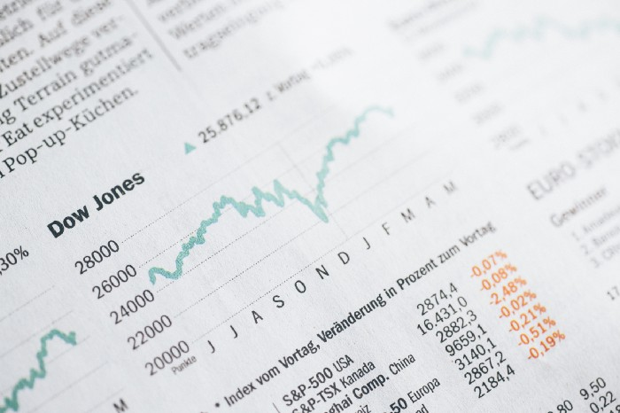
Sentiment Analysis of Stocks from Financial News using Python
Ravi Pratap Singh 17045083
Notes:
We performed sentiment analysis on the news headlines of a company and calculated whether the headlines have positive sentiment or negative sentiment.

Slide 2

Stock market is one of the most sensitive field , sentiment of people can change the trend of the entire market.
News articles can have observable effect on investors towards the financial market

Slide 3
Methodology
Following system design is implemented in this project to calculate sentiment scores for the news headlines.
News Collection
Data Extraction and text pre-processing
Sentiment Analysis
Data visualisation

Slide 4
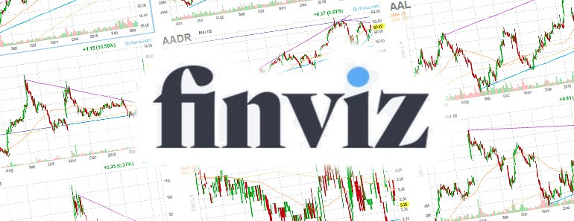
News collection
News headlines was obtained from finviz website.
Only news Headlines was used because news headlines are enough to understand the sentiment of the content.

Slide 5

Data Extraction
Data obtained from finviz website is an html response . The Data required is in tables which is enclosed in different html tags.
News Headlines, date and time and company name was parsed and stored in the Dataframe

Slide 6
How Sentiment score is calculated?
Before applying sentiment detection algorithm text is pre-processed.
Text Pre-processing:
Removal of noisy words(numbers, more white spaces, tabs, punctuation characters, stop words etc.)
Stemming: Using stemming process, all the words are replaced by its original version of word. For example, the words ‘developed’, ‘development’, ‘developing’ are reduced to its stem word ‘develop’.

Slide 7
Sentiment Detection Algorithm
The algorithm to calculate sentiment score of a news headline is given below.
Tokenize the headline into word vector.
Dictionary of words which contains words with its polarity (positive or negative)
Check against each word weather it matches with one of the word from positive word dictionary or negative words dictionary.
Count number of words belongs to positive and negative polarity.
Calculate Score of document = count (pos.matches) – count (neg.matches)
If the Score is 0 or more, we consider the headline is positive or else, negative.

Slide 8
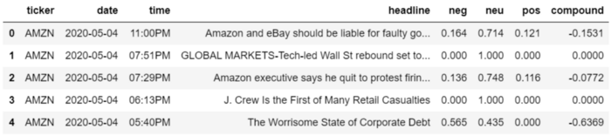
Sentiment Analysis with Vader!
Company name, date, time, headlines were stored in Pandas DataFrame and sentiment analysis was performed on the headlines before adding additional columns in the DataFrame to store the sentiment scores for each headline.

Slide 9
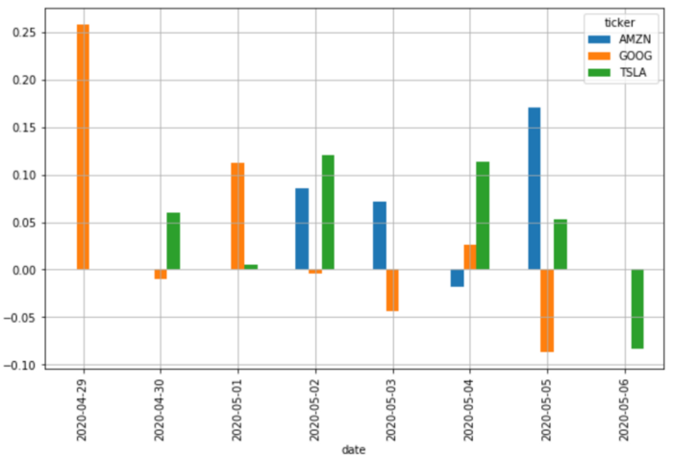
Data Visualization
We calculated average of the sentiment scores for all news headlines collected during each date and ploted it on a bar chart.

